Slide 1

Staffordshire Warmer Homes
Warmer Homes Local Grant (WH:LG)
Partner and stakeholder briefing pack
Year 1 - 2025/2026 – DRAFT Ver.2 18/11/25

Slide 2


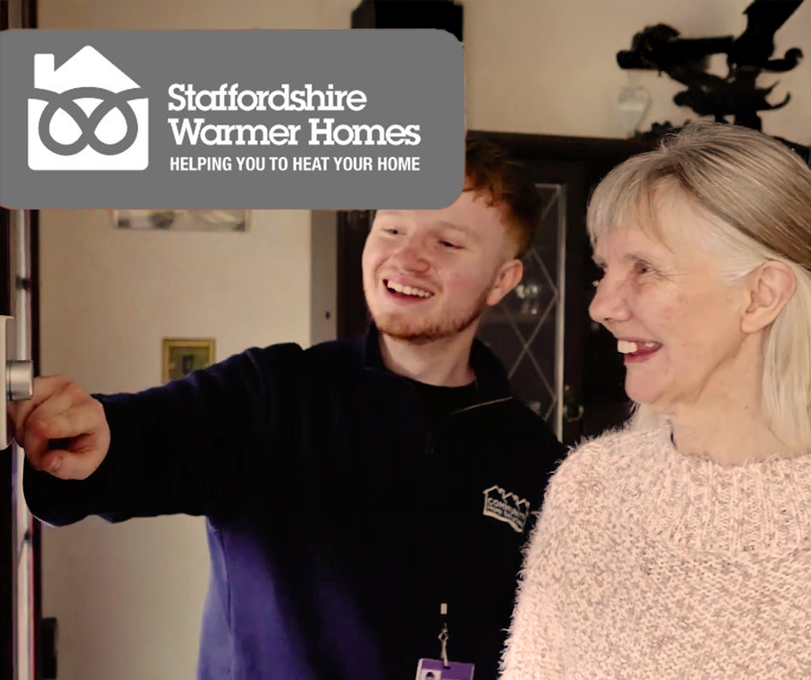
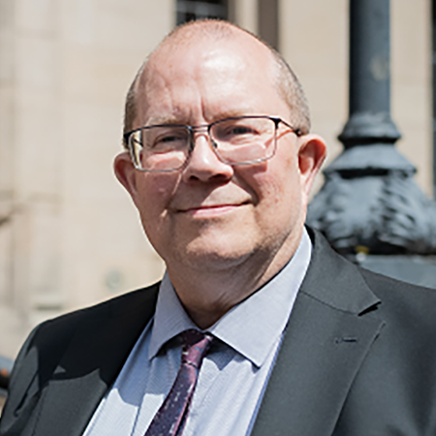
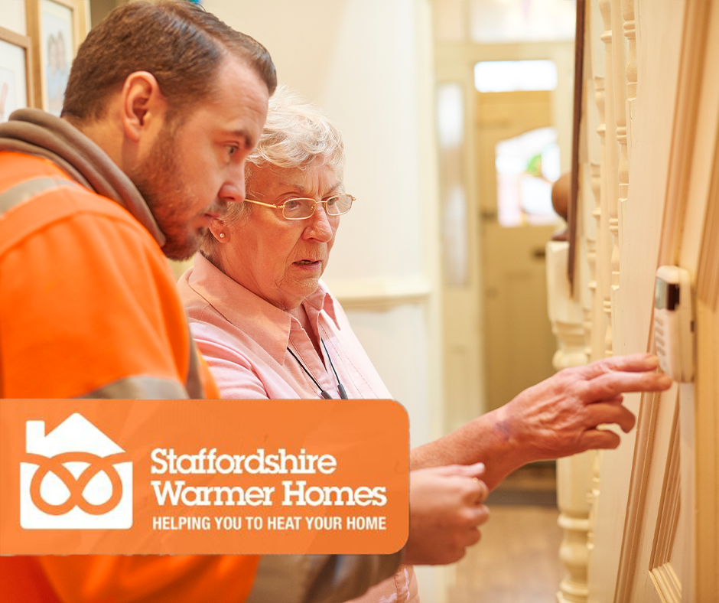
Staffordshire Warmer Homes – Warm Homes: Local Grant Year 1 2025/26
Helping residents heat their homes for less - safely, fairly and together.
“Keeping Staffordshire’s residents warm and well through the winter is one of our top public health priorities.
The new Warm Homes: Local Grant helps us focus support where it’s needed most - making homes warmer, healthier and more affordable to heat.
Working with our district councils, Community Home Solutions and local partners, we can tackle fuel poverty across Staffordshire in a joined-up way.”
Cllr Martin Rogerson, Cabinet Member for Health and Care, Staffordshire County Council

Slide 3
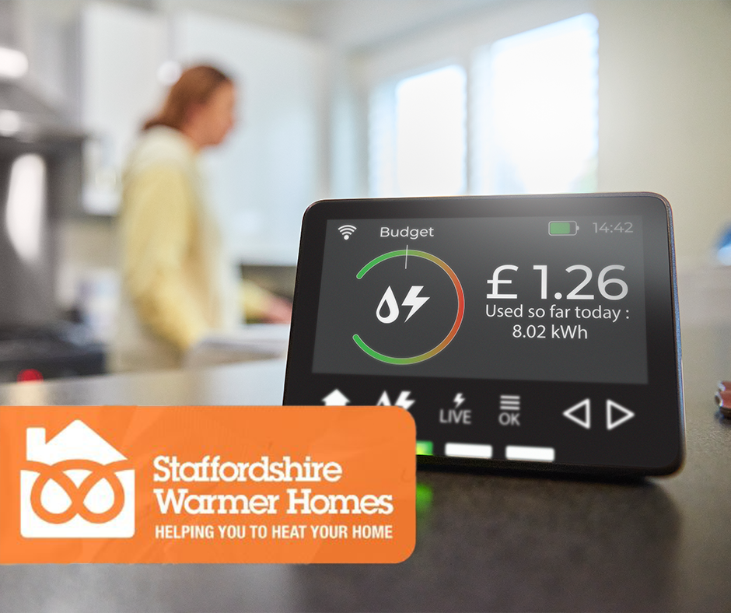

Staffordshire Warmer Homes – Warm Homes: Local Grant 2025/26
Together we’re making Staffordshire’s homes warmer, healthier and more affordable to heat.
“Cold homes can seriously harm health, increasing the risk of respiratory and heart illness and even hospital admissions.
The Warm Homes: Local Grant builds on our successful Staffordshire Warmer Homes programme, targeting our residents most affected by fuel poverty and energy inefficient housing.
This briefing pack provides key information, consistent messages and ready-to-use tools for all our partners.
Together, we can help ensure Staffordshire residents know where to turn for trusted local support - and that help reaches those who need it most.”
Dr Richard Harling, Director for Health and Care, Staffordshire County Council

Slide 4
About the scheme
Our shared goal: To combat fuel poverty across Staffordshire and help residents heat their homes for less using energy-efficient solutions.
What is Staffordshire Warmer Homes
About the new Warm Homes: Local Grant
A countywide programme led by Staffordshire County Council, working in partnership with all eight district and borough councils and Community Home Solutions (CHS) as delivery partner.
The programme accesses funding from several energy efficiency schemes to provide predominantly free, or heavily subsidised home heating and insulation measures for eligible low-income or vulnerable households.
The Warm Homes: Local Grant is the new scheme that supports residents with free energy efficiency improvements to their homes through improved insulation and heating.
The Warm Homes: Local Grant (WHLG) opens for new applications in November 2025. It replaces the previous Home Upgrade Grant phase and will:
Support on-and-off-gas homes.
Target fuel-poor homes to reach EPC Band C by 2030.
Deliver approx. 284 installations by March 2028.
Impact so far
Since 2019, Staffordshire Warmer Homes has:
Installed over 2,400 energy measures in 1,450 homes
Improved 92% of properties by at least one EPC band
Saved residents nearly £1.5m in energy bills
Reduced carbon emissions by almost 3,000 tonnes

Slide 5

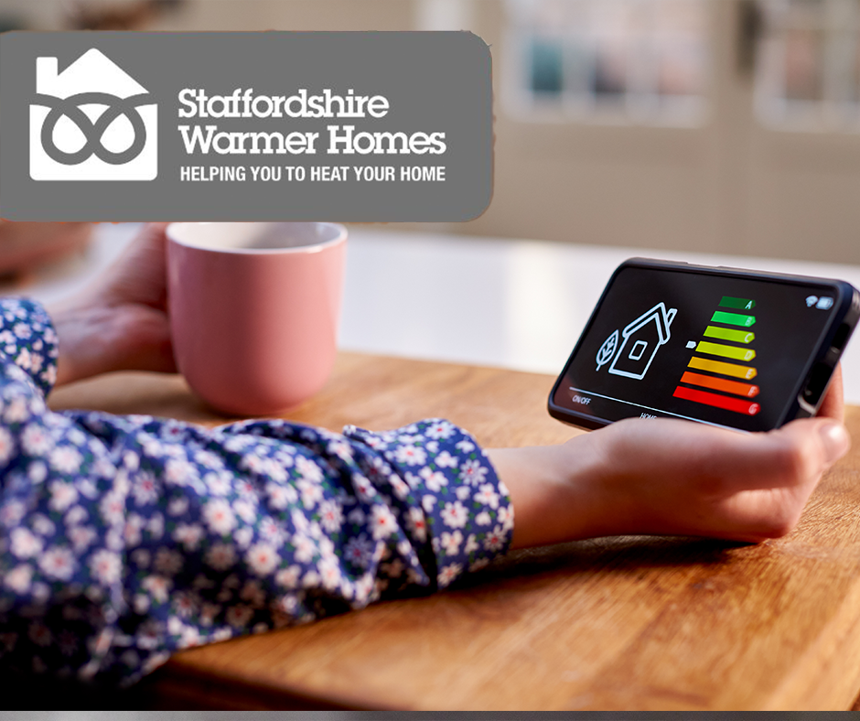
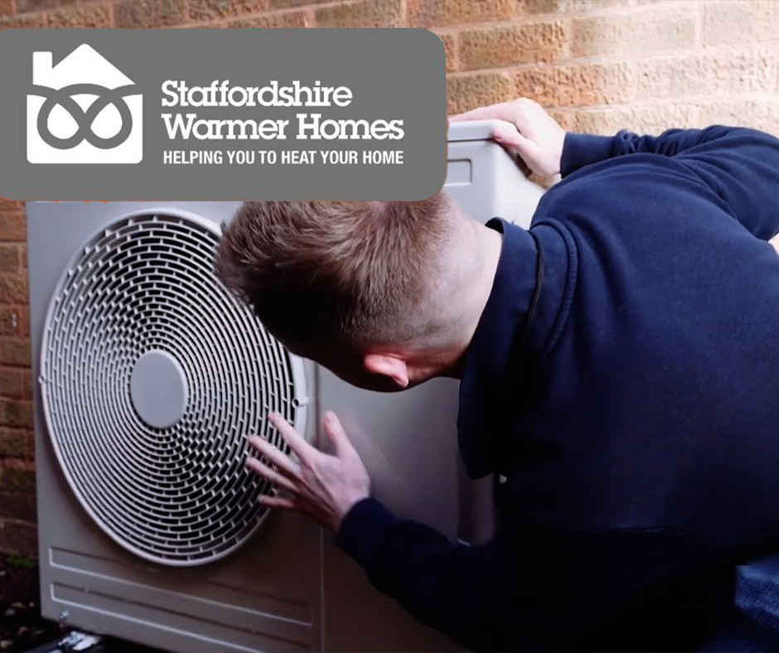
What’s new in 2025/26
Key changes partners should note
 | 2024/25 (Home Upgrade Grant) | 2025/26 (Warm Homes: Local Grant
Eligibility | Off-gas only | All fuel types (on/off gas)
Income limit | £31k | £36k*
Approach | First-come | Prioritised based on need
Focus | Energy efficiency | Health and wellbeing
Measures | Limited | Full suite inc. renewables
Priorities
Supporting residents most at risk from cold homes.
Aligning with National Institute for Health and Care Excellence guidance (NG6) on health and housing.
Maximising the public health benefit per pound spent.
* Can have higher income in some circumstances

Slide 6
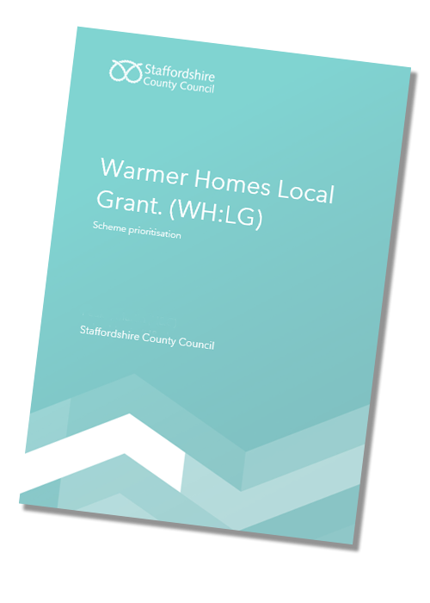
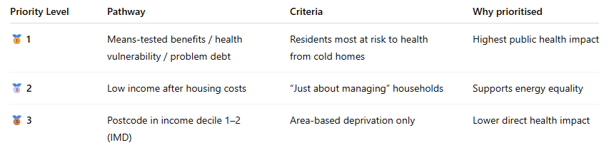
Eligibility and prioritisation
Who can apply
Residents may qualify if they:
Have a household income of £36,000 or less; or
Receive means-tested benefits (e.g. Universal Credit, Pension Credit, Income Support); or
Have a health condition worsened by living in a cold home; and
Are in problem debt or financial hardship.
Applicants must live in Staffordshire and own or privately rent a home that is inefficient or hard to heat.
How we prioritise applications
Because demand is high, eligibility does not guarantee installation.
Funding is allocated based on a transparent three-pathway prioritisation model:
Our prioritisation document is available to download here. (PDF)
This provides a summary of our prioritisation model and provides the rationale behind this approach.
Line to take: “The scheme is not first-come, first-served.
We’re prioritising those most affected by cold homes and poor health, based on national public health guidance.”

Slide 7
Customer journey and delivery
Resident journey
1️⃣ Apply online or by phone
Residents apply via the Staffordshire Warmer Homes website or call 0115 718 1822. The call line is managed by Community Home Solutions (CHS).
2️⃣ Eligibility and prioritisation check
CHS verifies income, health or vulnerability criteria, and housing conditions.
3️⃣ Home survey and recommendations
A qualified assessor visits to determine suitable measures (e.g. insulation, solar panels, air source heat pump).
4️⃣ Installation and aftercare
Accredited installers complete works; Community Home Solutions and Staffordshire Warmer Homes teams manage quality checks and feedback.
📌 Image: Happy customer / aftercare
Delivery Roles
Staffordshire County Council: Programme lead, public health oversight, communications.
District and Borough Councils: Local awareness, resident referral, community engagement.
Community Home Solutions (CHS): Customer journey support

Slide 8
Consistent messaging and communications toolkit
To provide one clear, consistent story that every partner can confidently tell, across press releases, websites, social media, newsletters, and councillor briefings..
The Narrative: Helping Staffordshire stay warm and well
Key point to emphasise
Staffordshire Warmer Homes is here to help local people heat their homes for less. Led by Staffordshire County Council, working in partnership with all eight district and borough councils and Community Home Solutions, the scheme provides predominantly free or, subsidised energy efficiency improvements — like insulation, heating upgrades, and solar panels — to residents most in need.
This year’s new Warm Homes: Local Grant focuses on keeping Staffordshire’s most vulnerable households safe, healthy, and warm through the winter. The scheme prioritises those living on low incomes and with health conditions made worse by cold homes, ensuring support goes where it’s needed most.
Together, our councils and community partners are helping more residents enjoy a warmer, healthier home, lower energy bills, and peace of mind this winter and beyond.
Free or subsidised heating and insulation available.
Open to all fuel types – on and off gas.
Prioritised for those most in need (income, health, vulnerability).
Apply via www.staffordshire.gov.uk/warmerhomes or call 0115 718 1822 .
Limited funding – not first-come, first-served.
“Staffordshire Warmer Homes helps residents heat their homes for less, stay healthy, and reduce their energy bills through funded home improvements.”

Slide 9
Key messages framework
Theme | Message | Audience Use
Purpose | Staffordshire Warmer Homes helps residents heat their homes for less by providing funded energy-saving home improvements. | All
Partnership | Delivered by Staffordshire County Council in partnership with district and borough councils, Community Home Solutions and other community partners. | Press, internal
Impact | Since 2019, more than 1,450 homes have been improved across Staffordshire, cutting bills and carbon. | Press, internal
Eligibility | Open to households with income up to £36,000 or those with health vulnerabilities or problem debt. | Resident-facing
Prioritisation | Funding is limited - priority is given to those most affected by cold homes or poor health. | All
Health | Living in a warm home supports better physical and mental health. | Public health, resident
How to apply | Apply via www.staffordshire.gov.uk/warmerhomes or call 0115 718 1822 (Call line managed by Community Home Solutions). | All
Tone to maintain | Warm, professional, trustworthy - "helping people live well for less." | All
..

Slide 10
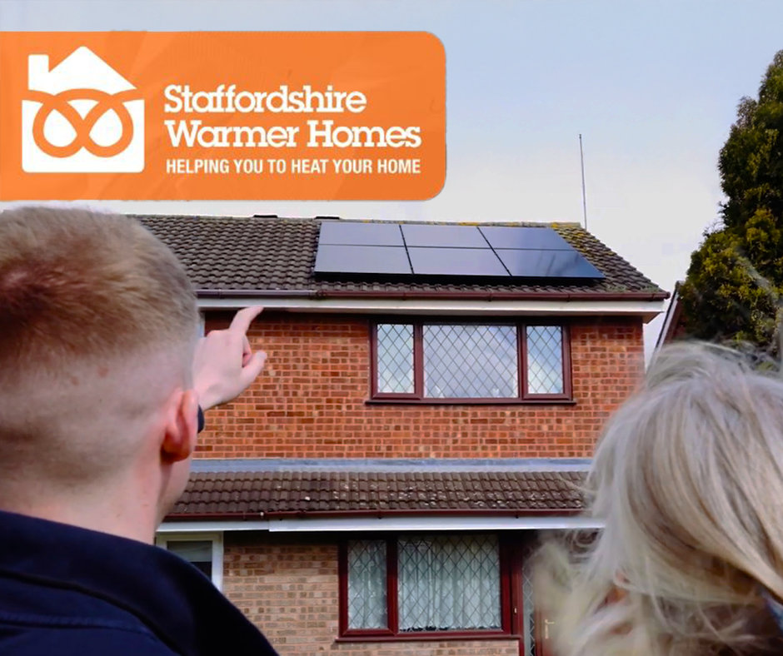
News Template
(Partners can adapt this for local distribution.)
New funding to help Staffordshire residents stay warm and well this winter
A new phase of the Staffordshire Warmer Homes scheme is opening for applications this November, helping residents across the county heat their homes for less with funded insulation and renewable heating improvements.
The Warm Homes: Local Grant, led by Staffordshire County Council in partnership with district and borough councils, Community Home Solutions and other local partners, provides free energy-saving upgrades to eligible low-income or vulnerable households.
The scheme offers improvements such as loft and wall insulation, air source heat pumps, hybrid gas heating systems, and solar panels — all designed to make homes warmer, healthier, and cheaper to heat.
Cllr Martin Rogerson, Cabinet Member for Health and Care at Staffordshire County Council, said:
“Keeping Staffordshire’s residents warm and well through the winter is one of our top public health priorities.
The new Warm Homes: Local Grant scheme helps us focus support where it’s needed most - making homes warmer, healthier and more affordable to heat. Working with our district councils, Community Home Solutions and local partners, we can tackle fuel poverty across Staffordshire in a joined-up way.”
[Insert local partner spokesperson quote – e.g. [Name],at [Your organisation] added:
[Insert your quote -e.g. “This is a countywide effort, delivered locally. The improvements funded through the programme can make homes warmer, healthier and more affordable to heat, now and for years to come.”]
Eligible residents can apply online at www.staffordshire.gov.uk/warmerhomes or call 0115 718 1822 for help completing their application
ENDS
📌Please inform the SWH team of any media release of your own you are planning to put out. Any media or communications queries should be directed to pressoffice@staffordshire.gov.uk .

Slide 11
Social media posts
(Partners can adapt this for local distribution)
🟩 Post 1 – Launch Awareness
❄️ Applications are now open for the new Warm Homes: Local Grant — helping Staffordshire residents heat their homes for less this winter.
Free home upgrades available for eligible households.
🔗 Apply now: www.staffordshire.gov.uk/warmerhomes
☎️ Or call 0115 718 1822 for support.
Delivered by Staffordshire County Council and partners.
🟩 Post 2 – Health and Wellbeing Focus
❄️ Living in a cold home can harm your health.
The Warm Homes: Local Grant through Staffordshire County Council provides free fully funded heating and insulation upgrades to help keep Staffordshire residents warm, well, and worry-free.
👉Check eligibility: www.staffordshire.gov.uk/warmerhomes
☎️ Or Call 0115 718 1822
Delivered by Staffordshire County Council and partners.
🟩 Post 3 – Energy Savings / Community Focus
🏠Over 1,400 Staffordshire homes have already been improved through Staffordshire Warmer Homes.
Could yours be next?
Apply for the new Staffordshire Warmer Homes ‘Warm Homes: Local Grant’ and save money on energy bills this winter.
🌐 www.staffordshire.gov.uk/warmerhomes
☎️ 0115 718 1822
Delivered by Staffordshire County Council and partners.
📌 Suggested Visual:
Warm, inviting home scene — family sitting comfortably indoors, “Now open for applications” overlay.
📌 Suggested Visual:
Elderly resident with a cup of tea by a radiator; health and wellbeing callout: “A warmer home means a healthier winter.”
📌 Suggested Visual:
Before-and-after home insulation comparison graphic or smiling resident testimonial quote overlay.
📌 Design note: Please use Staffordshire Warmer Homes branding and consistent hashtag: #StaffsWarmerHomes.

Slide 12

Webpage or newsletter copy (public-facing)
(Partners can adapt this for local distribution)
Helping Staffordshire residents heat their homes for less
The new Warm Homes: Local Grant is now open for applications, helping eligible households in Staffordshire access free home energy improvements.
Led by Staffordshire County Council and delivered in partnership with local district and borough councils and Community Home Solutions, the scheme helps residents stay warm, reduce bills and improve their health through measures such as insulation, solar panels and modern heating systems.
Priority is given to those most affected by cold homes — including residents with low incomes, health conditions and financial hardship.
Find out more or apply today at: www.staffordshire.gov.uk/warmerhomes or call 0115 718 1822.
Funding is limited – apply early to avoid disappointment.

Slide 13
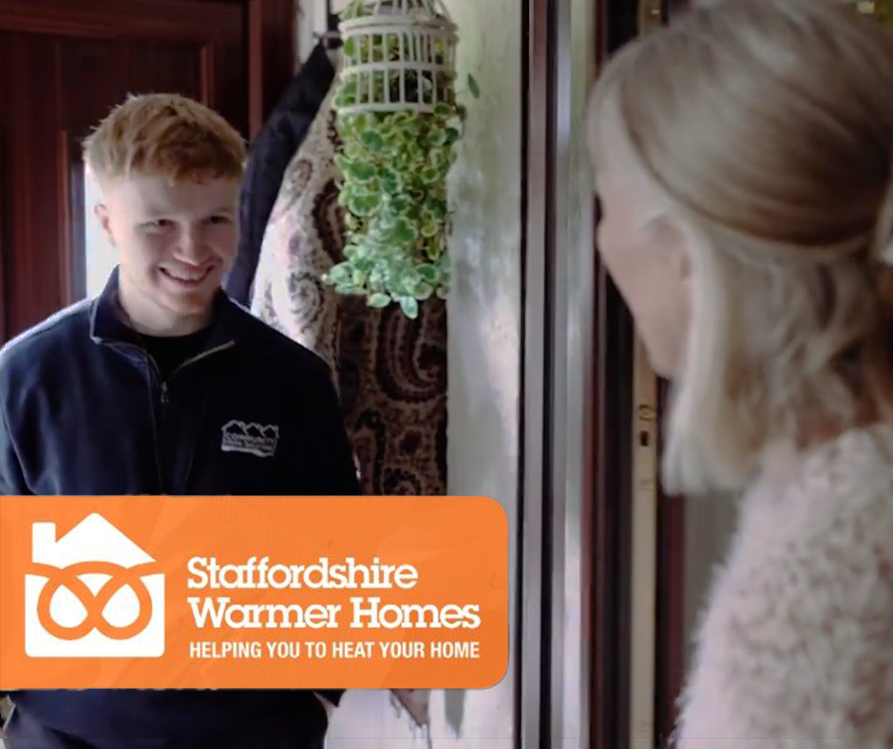
Internal Communications Copy (For Partner Staff and Councillors)
(Partners can adapt this for local distribution)
Briefing for internal staff and councillors –
Warm Homes: Local Grant 2025/26
Staffordshire County Council has launched the new Warm Homes: Local Grant, offering funded energy efficiency improvements to eligible households across the county.
The scheme focuses on supporting residents most at risk from living in cold homes, including those with low incomes or health conditions affected by poor housing.
Staff and councillors can help by:
Signposting residents to the official webpage: www.staffordshire.gov.uk/warmerhomes
Sharing the official posts on social media
Using the agreed messaging to maintain consistency across networks
Any media or communications queries should be directed to pressoffice@staffordshire.gov.uk.

Slide 14
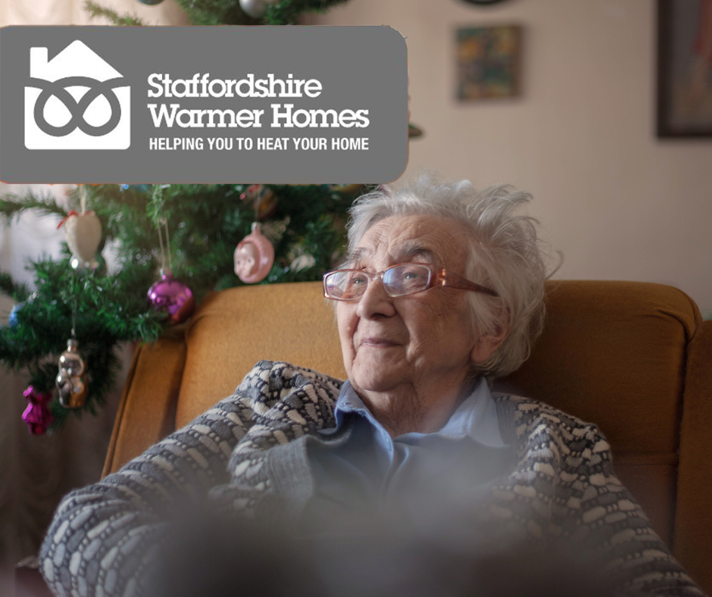
Web banner copy options
(Partners can adapt this for local distribution)
Option 1 – Simple awareness banner
Option 2 – Health and Support Focus
Warm Homes: Local Grant – Apply now for free home heating and insulation upgrades. Priority for those most in need.
🔗 www.staffordshire.gov.uk/warmerhomes
Cold homes can harm your health.
The Warm Homes: Local Grant is here to help.
Apply now for fully funded home improvements:
🔗 www.staffordshire.gov.uk/warmerhomes
📌 Design note: banner visuals – warm indoor photo, Staffordshire Warmer Homes logo, “Apply Now” button graphic..

Slide 15

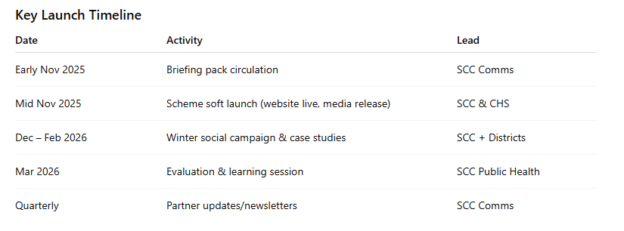

Partner actions and launch timeline
Side-by-side infographic of this table with icons (thermometer, heart, coins, etc)
How partners can help
Share the consistent messages on your websites, social media and newsletters.
Brief frontline staff to confidently explain eligibility and prioritisation.
Refer eligible residents to apply via the official routes only.
Avoid raising expectations – reinforce that funding is limited and prioritised.
Collect case studies and feedback to share with SCC Communications.
Graphics are available here, but feel free to use your own and localise your content for your needs

Slide 16
Staffordshire Warmer Homes
Warmer Homes Local Grant (WH:LG)
Contacts
Programme lead: Staffordshire County Council – Public Health
📧 SWHTeam@staffordshire.gov.uk
☎️ 01785 895089 / 01785 276707
Delivery partner: Community Home Solutions
📧 info@communityhomesolutions.co.uk
☎️ 0115 718 1822
Main web address
www.staffordshire.gov.uk/warmerhomes

